Slide 1

GOOD AFTERNOON TO ALL

Slide 2

Teacher’s introducing.
Md. Ashraful Alam
Assistant Teacher
Aganagar Govt. Pri: School
Bhairab, Kishoreganj
Mobile No-01711-052305

Slide 3
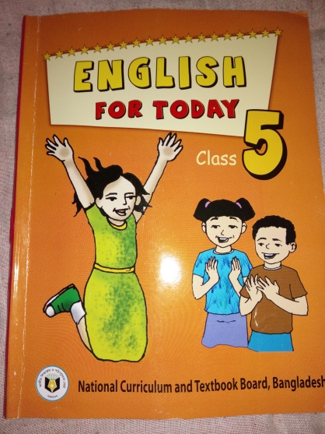
Lesson introduction
Class– Five
Subject-English
Unit– 24
Lesson: 1(b) (Cyclone Aila)
Date– 01.10.2017.

Slide 4
Let’s see a video

Slide 5
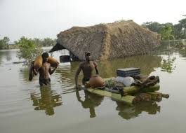
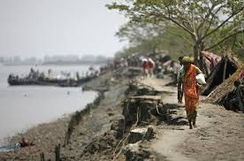
Look at the pictures and think about these.
What about are these pictures ?
These pictures are natural disaster
( flood and river erosion ).

Slide 6
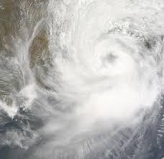
Today’s lesson is -
Aila
Cyclone

Slide 7
Learning outcomes--
Listening:
3.4.1:Understand statements made by teachers &students
Speaking
6.2.1:Talk about people, objects, events etc.
Reading:
1.5.1:Read words, phrases and sentence in the text with
Proper pronunciation, stress and intonation
writing:
3.1.1:Write words, phrases and sentences using non-
-cursive Capital and small letters.
8.1.1:Make sentences using words & Phrases given in
the textbook.

Slide 8
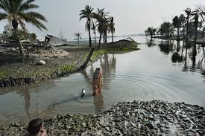
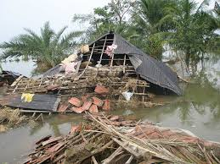
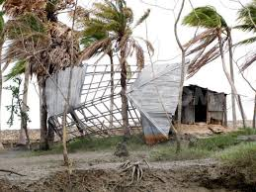
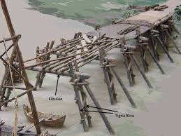
Everybody see the pictures and say , what are about these?
These pictures are about natural Calamity ‘Cyclone’.

Slide 9
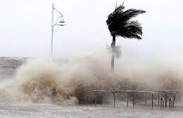
What are you looking at the pictures ?
The pictures are about ‘Cyclone Aila’

Slide 10
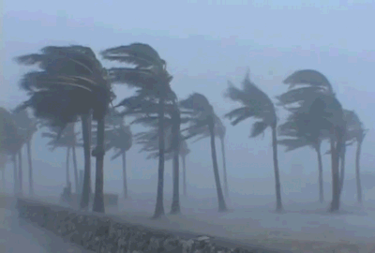
What can you see in the pictures ?
We can see the wind and rain are blowing heavily.

Slide 11
What can you see in the pictures ?
The river is rising.
Cyclone is in the Sea.

Slide 12
Let’s see another video-

Slide 13
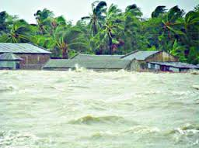
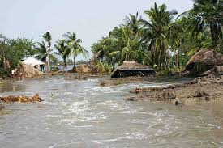
What can you see in the pictures ?
The river flooded the field.

Slide 14
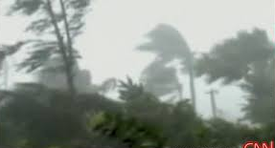
Look at the pictures and think about these.
Look at the pictures and think about these.
The wind is blowing and the roof away

Slide 15
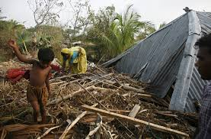
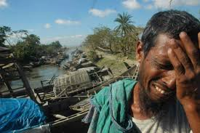
See another pictures and think about these
The wind has blown the roof away
and the man is so sorrow.

Slide 16
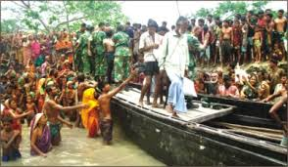
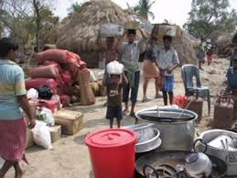
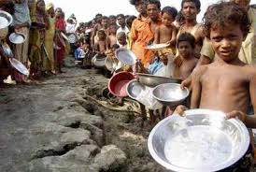
What can you see in pictures? Think about these.
The people are house & foodless for Cyclone Aila
The Army are distributing food to the people .

Slide 17
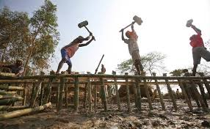
What can you see in the pictures ?
After Cyclone (Aila)
The bridge is damaged by Cyclone.
The workers are repairing the bridge.

Slide 18
Everybody look at the blackboard and
write the meaning of these words,
Rising
Flooded
Blowing
Roof
Away
Repairing
বৃদ্ধি পাওয়া
বন্যাকবলিত / পানিতে ডুবে যাওয়া
বহা ( বাতাস বহা )
ছাদ / ঘরের চালা
উড়িয়ে নেয়া
মেরামত করা / পুনরায় তৈরি করা

Slide 19
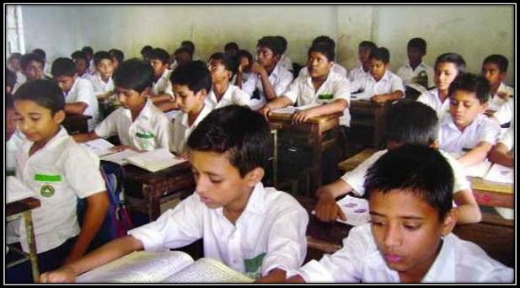
Everybody take your book and open page at 94 .

Slide 20
Everybody take your book and open page at 94.
Read the sentences. Number them in correct order from 1 to 4.
-------The workers are repairing the huts and fields.
-------The river is rising and the winds are blowing.
-------The storm starts.
-------The wind is blowing the roofs away and the river
is flooding the fields.

Slide 21
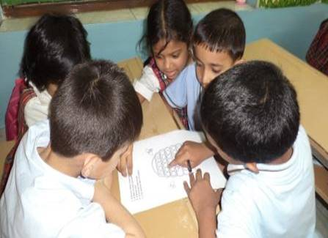
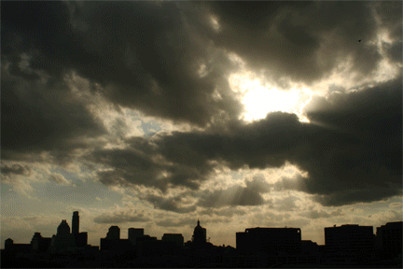
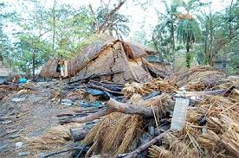
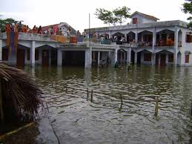
Look at the pictures and discuss in groups.
The sky is cloudy
The wind is starting
The wind has broken
house & trees
People has gone in
shelter center

Slide 22

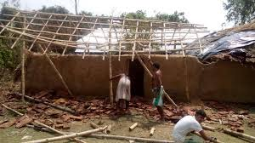
Look at the pictures and discuss in pairs
The wind is blowing and the roof away.
The house is repairing.

Slide 23

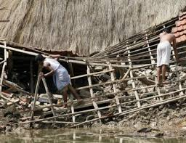
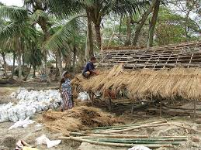
Look at the pictures and think about these lonely
The houses are repairing after Aila

Slide 24
Evalution
Read the sentences. Number them in correct order from 1 to 4.
-------The workers are repairing the huts and fields.
-------The river is rising and the winds are blowing.
-------The storm starts.
-------The wind is blowing the roofs away and the river
is flooding the fields.
1. The storm starts.
2. The river is rising and the winds are blowing.
3. The wind is blowing the roofs away and the river
is flooding the fields.
4. The workers are repairing the huts and fields.
4
2
1
3

Slide 25
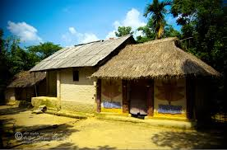
Home work
Everybody will read today’s lesson at your home
and will make the sentences in past form.

Slide 26

GOOD-BYE TO ALL FOR TODAY.

